Slide 1
Explaining robot parts presentation
Mawaheb Runners

Slide 2
Parts Used
1) Arduino NANO
2) Six Ultra Sonics
3) One DC Motor
4) One Servo Motor
5) H-bridge
6) One raspberry pi
7) One Camera
8) One Power Bank
9) One lamp

Slide 3
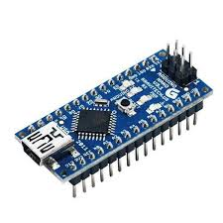
First: Arduino NANO
The Arduino is used in applying or modifying the robots code or as we call it the brain of the robot it helps in moving the robot and avoid the needed obstacles around the needed area

Slide 4
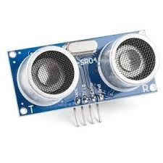
Second : Ultra sonic
The ultra sonic is used to see and detect the walls around our robot so it can know when to turn and when to move in a straight line it detects the walls by using sonic waves that bounces from the wall and back to the receiving end on the ultra sonic

Slide 5
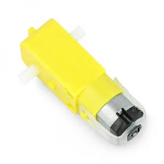
Third :DC Motor
The motor is used to move the robot around the needed course whether that be forward or backword

Slide 6
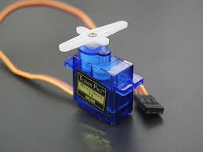
Fourth : Servo Motor
The servo is used to steer the robot left and right to help with avoiding the obstacles

Slide 7
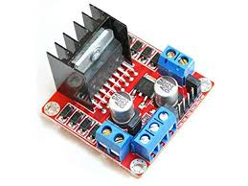
Fifth :H-Bridge
The H-Bridge is used to control the direction of a motor. It can drive a motor forwards, backwards, or stop it altogether by switching the polarity of the voltage applied to the motor.

Slide 8
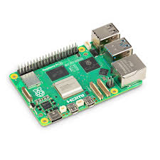
Sixth :Raspberry Pi
The raspberry pi is used to use the videos from the camera to give different orders to the Arduino to avoid the obstacles Infront of the robot.

Slide 9
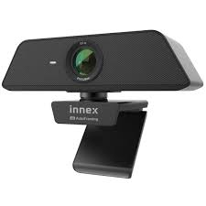
Seventh :Camera
The camera is used to detect the different colours Infront of the robot and tell the raspberry pi to send a signal to the Arduino to move right if the block is red and left if green

Slide 10
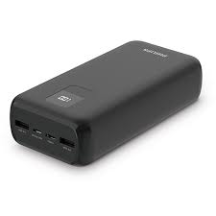
Eighth : Power Bank
The power bank is used to give the raspberry pi the electricity needed in order for the raspberry pi to work effectively

Slide 11
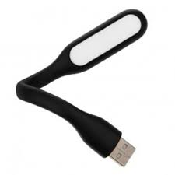
Ninth : Lamp
The lamp is used to light the way Infront of the robot so the camera can detect colours of the blocks without any colour errors

Slide 12
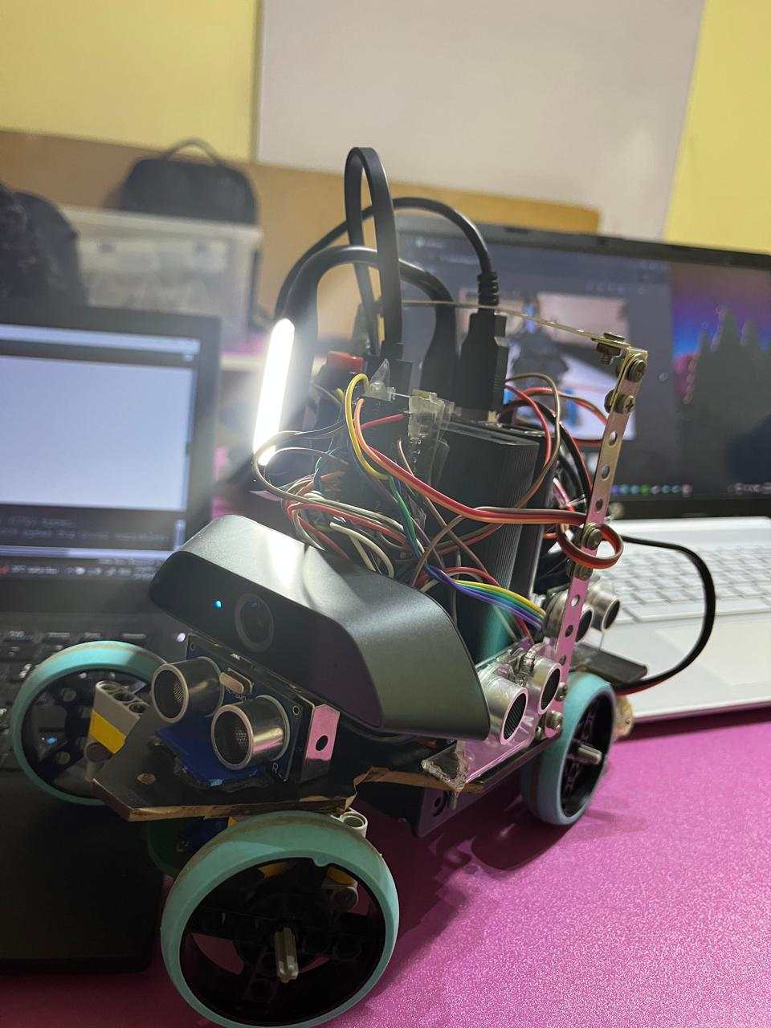
Thank you for your time

